Slide 1
Introduction to Management and Organizations
Chapter
1
© 2007 Prentice Hall, Inc.
All rights reserved.

Slide 2
L E A R N I N G O U T L I N E
Follow this Learning Outline as you read and study this chapter.
Who Are Managers?
  Explain how managers differ from non-managerial employees.
  Describe how to classify managers in organizations.
What Is Management?
  Define management.
  Explain why efficiency and effectiveness are important to management.
© 2007 Prentice Hall, Inc. All rights reserved.
1–<number>

Slide 3
L E A R N I N G O U T L I N E (cont’d)
Follow this Learning Outline as you read and study this chapter.
What Do Managers Do?
  Describe the four functions of management.
  Explain Mintzberg’s managerial roles.
  Describe Katz’s three essential managerial skills and how the importance of these skills changes depending on managerial level.
  Discuss the changes that are impacting managers’ jobs.
  Explain why customer service and innovation are important to the manager’s job.
© 2007 Prentice Hall, Inc. All rights reserved.
1–<number>

Slide 4
L E A R N I N G O U T L I N E (cont’d)
Follow this Learning Outline as you read and study this chapter.
What Is An Organization?
  Describe the characteristics of an organization.
  Explain how the concept of an organization is changing.
Why Study Management?
  Explain the universality of management concept.
  Discuss why an understanding of management is important.
  Describe the rewards and challenges of being a manager.
© 2007 Prentice Hall, Inc. All rights reserved.
1–<number>

Slide 5

Who Are Managers?
Manager
  Someone who coordinates and oversees the work of other people so that organizational goals can be accomplished.
  Manager job is not just doing their own work but also other managerial duties
© 2007 Prentice Hall, Inc. All rights reserved.
1–<number>

Slide 6
Classifying Managers
First-line Managers
  Individuals who manage the work of non-managerial employees. They are at the lowest level of management.
  Titles: Supervisor, Shift Manager, Office Manager.
Middle Managers
  Individuals who manage the work of first-line managers.
  Titles: Regional Manager, Project Leader, Store Manager, Division Manager.
Top Managers
  Individuals who are responsible for making organization-wide decisions and establishing plans and goals that affect the entire organization.
  Titles: CEO, Managing Director, President, COO.
© 2007 Prentice Hall, Inc. All rights reserved.
1–<number>

Slide 7
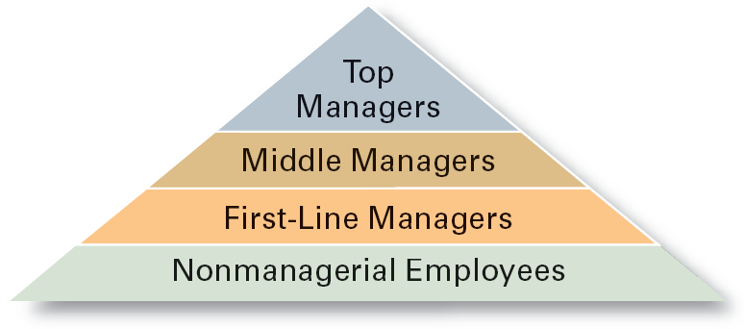
Exhibit 1–1 Managerial Levels
© 2007 Prentice Hall, Inc. All rights reserved.
1–<number>

Slide 8
What Is An Organization?
An Organization Defined
  A deliberate arrangement of people to accomplish some specific purpose (that individuals independently could not accomplish alone).
Common Characteristics of Organizations
  Have a distinct purpose (goal)
  Composed of people
  Have a deliberate structure
© 2007 Prentice Hall, Inc. All rights reserved.
1–<number>

Slide 9
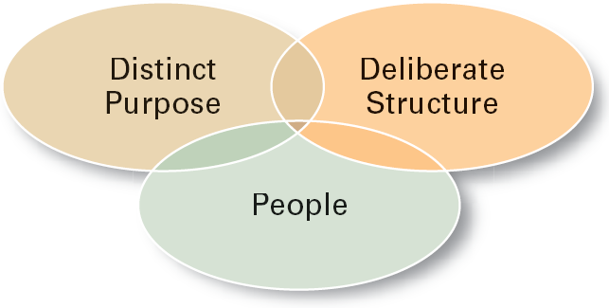
Exhibit 1–9 Characteristics of Organizations
© 2007 Prentice Hall, Inc. All rights reserved.
1–<number>

Slide 10
👉 Where Do Managers Work?
Managers work in organizations.
What is an organization?
An organization is a group of people arranged in a certain way to achieve a specific purpose.
All organizations have 3 common things:
A Purpose (Goals): Why the organization exists.
People: Who do the work to achieve that purpose.
A Structure: How the work and people are organized (it can be flexible like Google or strict like Procter & Gamble).
© 2007 Prentice Hall, Inc. All rights reserved.
1–<number>

Slide 11

What Is Management?
Management means coordinating and overseeing the work of others so that the work is done:
  Managerial Concerns
    Efficiency
      “Doing things right”
        Getting the most output for the least inputs
    Effectiveness
      “Doing the right things”
        Attaining organizational goals
© 2007 Prentice Hall, Inc. All rights reserved.
1–<number>

Slide 12
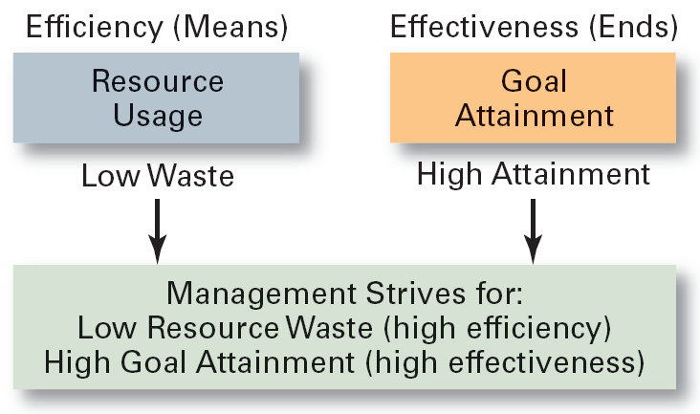
Exhibit 1–2 Effectiveness and Efficiency in Management
© 2007 Prentice Hall, Inc. All rights reserved.
1–<number>

Slide 13
What Do Managers Do?
Functional Approach
  Planning
    Defining goals, establishing strategies to achieve goals, developing plans to integrate and coordinate activities.
  Organizing
    Arranging and structuring work to accomplish organizational goals.
  Leading
    Working with and through people to accomplish goals.
  Controlling
    Monitoring, comparing, and correcting work.
© 2007 Prentice Hall, Inc. All rights reserved.
1–<number>

Slide 14
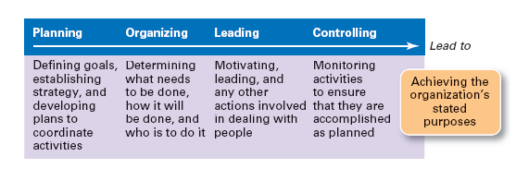
Exhibit 1–3 Management Functions
© 2007 Prentice Hall, Inc. All rights reserved.
1–<number>

Slide 15

What Do Managers Do? (cont’d)
Management Roles Approach (Mintzberg)
  Interpersonal roles
    Figurehead, leader, liaison
  Informational roles
    Monitor, disseminator, spokesperson
  Decisional roles
    Enterpreneur,Disturbance handler, resource allocator, negotiator
© 2007 Prentice Hall, Inc. All rights reserved.
1–<number>

Slide 16
What Do Managers Do? (cont’d)
Skills Approach
  Technical skills
    Knowledge and proficiency in a specific field
  Human skills
    The ability to work well with other people
  Conceptual skills
    The ability to think and conceptualize about abstract and complex situations concerning the organization
© 2007 Prentice Hall, Inc. All rights reserved.
1–<number>

Slide 17
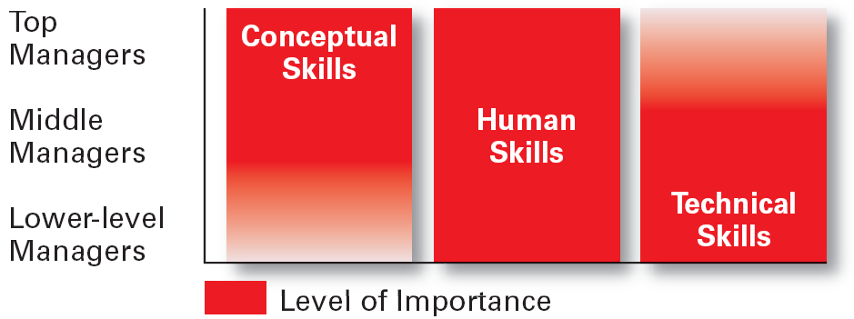
Exhibit 1–5 Skills Needed at Different Management Levels
© 2007 Prentice Hall, Inc. All rights reserved.
1–<number>

Slide 18
💻 Scenario: Launching a New Software Product at a Tech Company
👨‍💼 Top Managers (e.g., CTO, CEO)
Most Important Skill: Conceptual Skills
  These leaders focus on setting the vision and strategic direction for the software product.
  Example: The CTO defines how the new product aligns with emerging technologies like AI or cloud computing and how it fits into the company’s long-term roadmap.
🧑‍💼 Middle Managers (e.g., Product Managers, Engineering Managers)
Most Important Skill: Human Skills
  These managers coordinate teams, manage conflicts, and ensure that various departments (engineering, marketing, QA) work together smoothly.
  Example: The Product Manager collaborates with developers and designers, facilitating communication and aligning goals.
👨‍🔧 Lower-Level Managers (e.g., Team Leads, Tech Leads)
Most Important Skill: Technical Skills
  They are directly involved in the technical implementation and need a deep understanding of coding, architecture, or testing.
  Example: A Tech Lead writes code, reviews pull requests, and helps the team debug issues in the new software.
© 2007 Prentice Hall, Inc. All rights reserved.
1–<number>

Slide 19
Exhibit 1–6 Conceptual Skills
Using information to solve business problems
Identifying of opportunities for innovation
Recognizing problem areas and implementing solutions
Selecting critical information from masses of data
Understanding of business uses of technology
Understanding of organization’s business model
Source: Based on American Management Association Survey of Managerial Skills and Competencies, March/April 2000, found on AMA Web site (www.ama.org), October 30, 2002.
© 2007 Prentice Hall, Inc. All rights reserved.
1–<number>

Slide 20
Exhibit 1–6 Communication Skills
Ability to transform ideas into words and actions
Credibility among colleagues, peers, and subordinates
Listening and asking questions
Presentation skills; spoken format
Presentation skills; written and/or graphic formats
Source: Based on American Management Association Survey of Managerial Skills and Competencies, March/April 2000, found on AMA Web site (www.ama.org), October 30, 2002.
© 2007 Prentice Hall, Inc. All rights reserved.
1–<number>

Slide 21
Exhibit 1–6 Effectiveness Skills
Contributing to corporate mission/departmental objectives
Customer focus
Multitasking: working at multiple tasks in parallel
Negotiating skills
Project management :Project management is the process of planning, organizing, and managing resources to successfully complete a specific goal or project within defined constraints such as time, budget, and scope)
Reviewing operations and implementing improvements
Source: Based on American Management Association Survey of Managerial Skills and Competencies, March/April 2000, found on AMA Web site (www.ama.org), October 30, 2002.
© 2007 Prentice Hall, Inc. All rights reserved.
1–<number>

Slide 22
Exhibit 1–6 Effectiveness Skills (cont’d)
Setting and maintaining performance standards internally and externally
Setting priorities for attention and activity
Time management
Source: Based on American Management Association Survey of Managerial Skills and Competencies, March/April 2000, found on AMA Web site (www.ama.org), October 30, 2002.
© 2007 Prentice Hall, Inc. All rights reserved.
1–<number>

Slide 23
Exhibit 1–6 Interpersonal Skills (cont’d)
Coaching and mentoring skills
Diversity skills: working with diverse people and cultures
Networking within the organization
Networking outside the organization
Working in teams; cooperation and commitment
Source: Based on American Management Association Survey of Managerial Skills and Competencies, March/April 2000, found on AMA Web site (www.ama.org), October 30, 2002.
© 2007 Prentice Hall, Inc. All rights reserved.
1–<number>

Slide 24
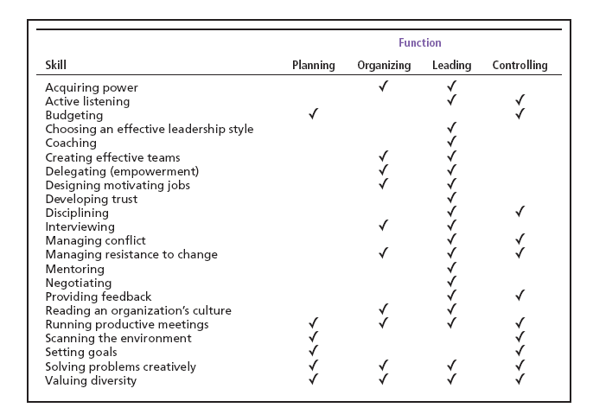
Exhibit 1–7 Management Skills and Management Function Matrix
© 2007 Prentice Hall, Inc. All rights reserved.
1–<number>

Slide 25
How The Manager’s Job Is Changing
The Increasing Importance of Customers
  Customers: the reason that organizations exist
    Managing customer relationships is the responsibility of all managers and employees.
    Consistent high quality customer service is essential for survival.
Innovation
  Doing things differently, exploring new territory, and taking risks
    Managers should encourage employees to be aware of and act on opportunities for innovation.
© 2007 Prentice Hall, Inc. All rights reserved.
1–<number>

Slide 26
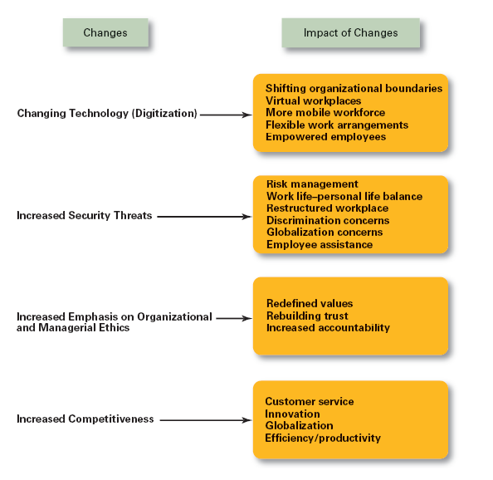
Exhibit 1–8
Changes Impacting the Manager’s Job
© 2007 Prentice Hall, Inc. All rights reserved.
1–<number>

Slide 27
Why Study Management?
The Value of Studying Management
  The universality of management
    Good management is needed in all organizations.
  The reality of work
    Employees either manage or are managed.
  Rewards and challenges of being a manager
    Management offers challenging, exciting and creative opportunities for meaningful and fulfilling work.
    Successful managers receive significant monetary rewards for their efforts.
© 2007 Prentice Hall, Inc. All rights reserved.
1–<number>

Slide 28
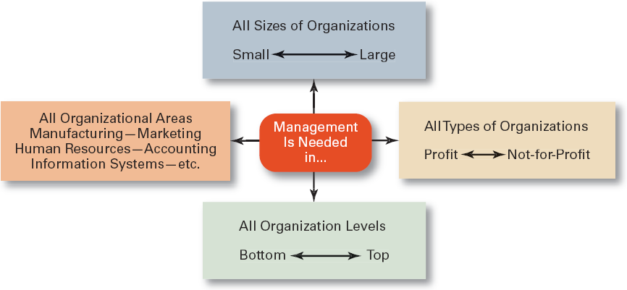
Exhibit 1–11 Universal Need for Management
© 2007 Prentice Hall, Inc. All rights reserved.
1–<number>

Slide 29
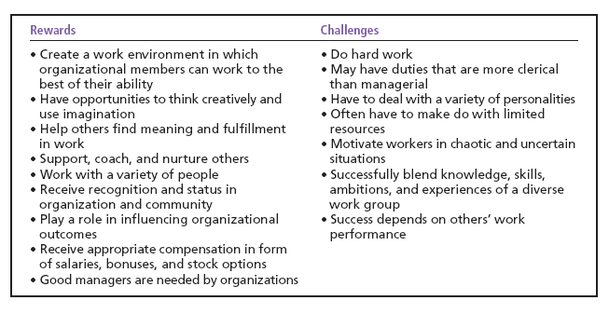
Exhibit 1–12 Rewards and Challenges of Being A Manager
© 2007 Prentice Hall, Inc. All rights reserved.
1–<number>

Slide 30
Terms to Know
manager
first-line managers
middle managers
top managers
management
efficiency
effectiveness
planning
organizing
leading
controlling
management roles
interpersonal roles
informational roles
decisional roles
technical skills
human skills
conceptual skills
organization
universality of management
© 2007 Prentice Hall, Inc. All rights reserved.
1–<number>

